Slide 1
06 | Introduction to Bootstrap
Jon Galloway | Technical Evangelist
Christopher Harrison | Content Developer

Slide 2
Bootstrap
The most popular front-end framework for developing responsive, mobile first projects on the web.

Slide 3
Why use it?
CSS is hard
Cross Browser
Solves basic tasks (e.g. getting tables right)
Bootstrap 3 makes it easier

Slide 4
Bootstrap Features
Theme Support
Responsive
Grid
Components
Pagination
Buttons
Modal
Great Visual Studio support

Slide 5
Theme Support

Slide 6
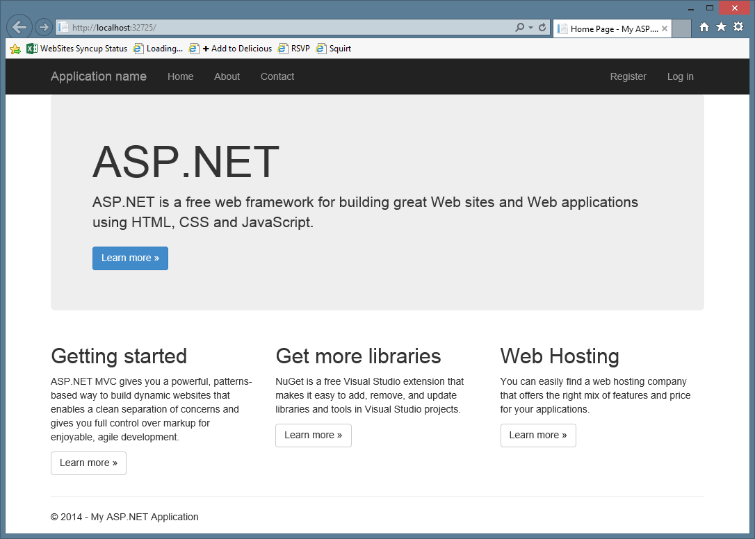

Slide 7
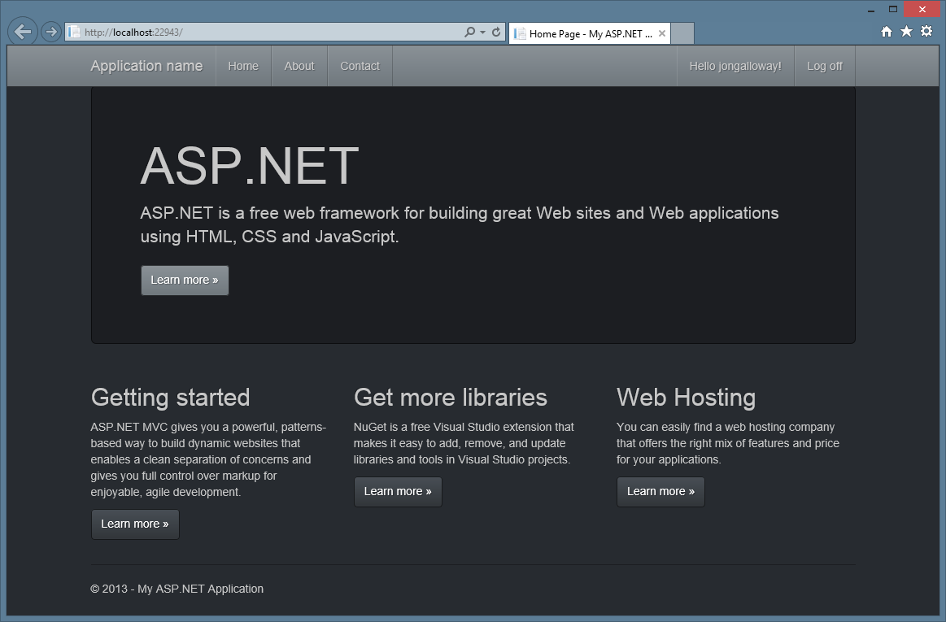

Slide 8
Bootstrap - Theme
Notes:
5 min bootstrap
Grid system
Screen sizes
Columns
3 column
4 colums
Mobile first
Responsive images
Buttons
Glyphicons
Email
Thumbnails
Facebook Login
Theming
bootswatch
Editor
Classes support
Scaffolding
Bootstrap styles
Browser support
Mobile friendly
Responsive

Slide 9
Responsive Layout
Notes:
Bootswatch

Slide 10
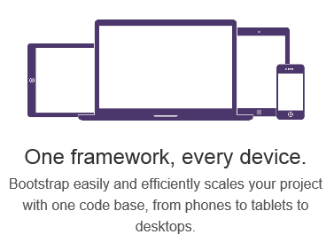
Responsive Layout

Slide 11
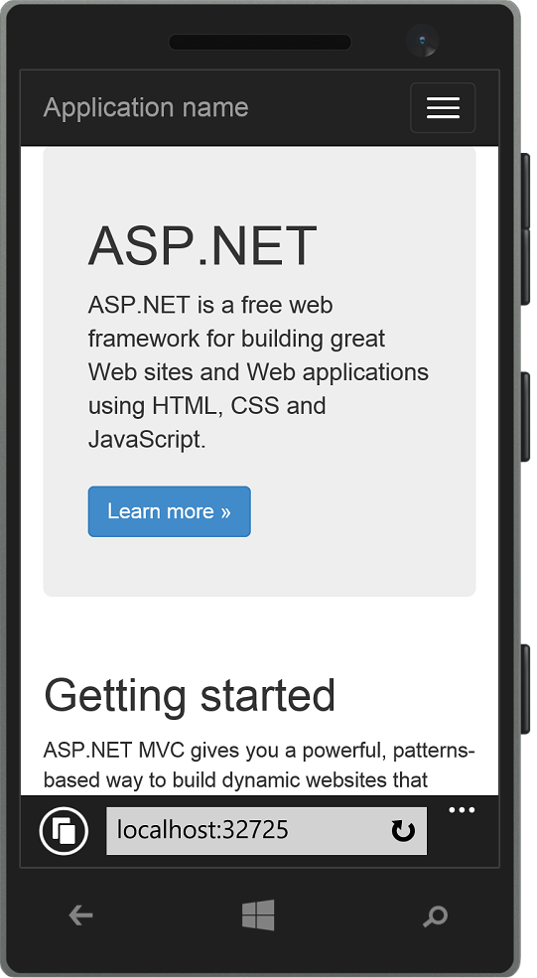
Responsive Layout

Slide 12
Bootstrap - Responsive
Notes:
5 min bootstrap
Grid system
Screen sizes
Columns
3 column
4 colums
Mobile first
Responsive images
Buttons
Glyphicons
Email
Thumbnails
Facebook Login
Theming
bootswatch
Editor
Classes support
Scaffolding
Bootstrap styles
Browser support
Mobile friendly
Responsive

Slide 13
Grid System

Slide 14
Grid system
 | Extra small devices Phones (<768px) | Small devices Tablets (≥768px) | Medium devices Desktops (≥992px) | Large devices Desktops (≥1200px)
Grid behavior | Horizontal at all times | Collapsed to start, horizontal above breakpoints
Container width | None (auto) | 750px | 970px | 1170px
Class prefix | .col-xs- | .col-sm- | .col-md- | .col-lg-
# of columns | 12
Column width | Auto | 60px | 78px | 95px
Gutter width | 30px (15px on each side of a column)

Slide 15
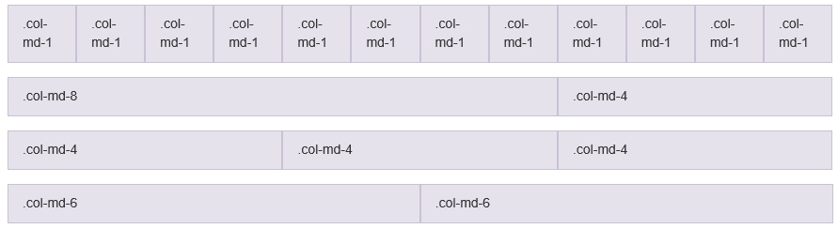
Grid system

Slide 16
Bootstrap - Grid
Notes:
5 min bootstrap
Grid system
Screen sizes
Columns
3 column
4 colums
Mobile first
Responsive images
Buttons
Glyphicons
Email
Thumbnails
Facebook Login
Theming
bootswatch
Editor
Classes support
Scaffolding
Bootstrap styles
Browser support
Mobile friendly
Responsive

Slide 17
Components

Slide 18





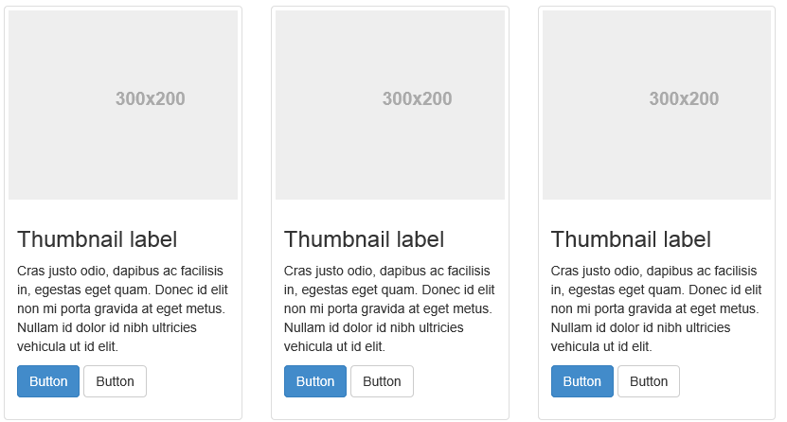
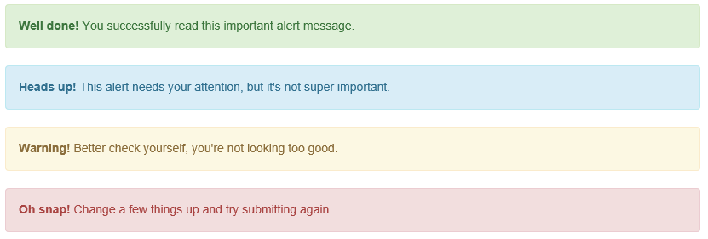
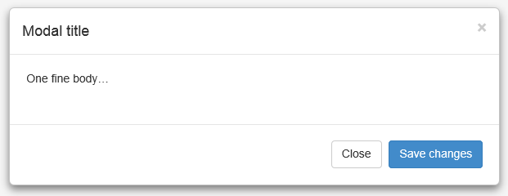
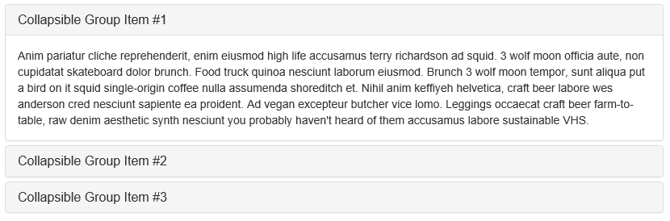
Components

Slide 19
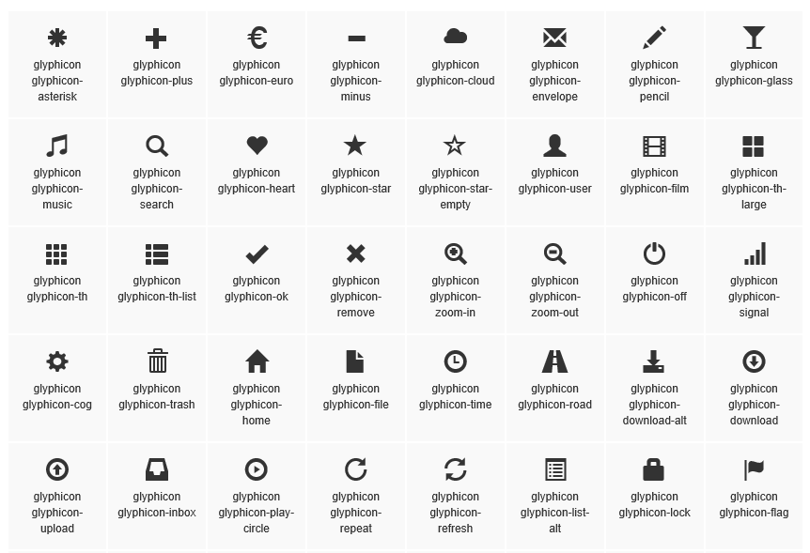
Glyphicons

Slide 20
Bootstrap - Components
Notes:
5 min bootstrap
Grid system
Screen sizes
Columns
3 column
4 colums
Mobile first
Responsive images
Buttons
Glyphicons
Email
Thumbnails
Facebook Login
Theming
bootswatch
Editor
Classes support
Scaffolding
Bootstrap styles
Browser support
Mobile friendly
Responsive

Slide 21
Visual Studio support

Slide 22
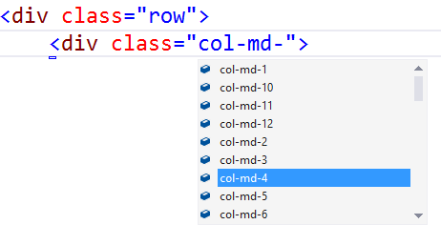
Visual Studio – Class IntelliSense

Slide 23
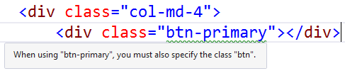
Visual Studio – Missing Class Detection

Slide 24
Bootstrap – Visual Studio Support
Notes:
5 min bootstrap
Grid system
Screen sizes
Columns
3 column
4 colums
Mobile first
Responsive images
Buttons
Glyphicons
Email
Thumbnails
Facebook Login
Theming
bootswatch
Editor
Classes support
Scaffolding
Bootstrap styles
Browser support
Mobile friendly
Responsive

